Slide 1
3160 Final Project
By Steven Marsh, Shiv Kaleria, Harrison Lilly, Flora Kunjumon

Slide 2
Data source:
Data and Source description: Our data source is randomly generated from http://www.generatedata.com.

Slide 3
Data source:
Data and Source description: Our data source is randomly generated from http://www.generatedata.com.

Slide 4
GitHub Link:
https://github.com/hlilly151/Database-Group-

Slide 5
Food delivery System Introduction
Our project is to track the data of a food delivery company. We are taking in account that the public universities do not want just anyone on campus. There is an issue with people who have no connections to the school going anywhere on campus to deliver food. So, in our project we are taking in account the delivery drivers have to be students or people who already have access to the school. In the relationship of our data we are also taking in consideration our customers which would be universities students, faculty, and staff.

Slide 6
Food delivery System Use case
The target of our idea is food delivery apps. The delivery app needs to have data on what food to use for ads. Each area/dorm is different for what people want. That app wants to target it's ads correctly and wants to ensure their customers are getting their food in a timely manner. With our data the app could see which drivers are rated the best and promote those accordingly. The information also ensures that the delivery drivers delivering the food already have access to the university. Delivery apps also want to know where to place their drivers in the right location at the right time. The data we have would benefit their business financially. The data we have could be sold to the restaurants as well for meta data on what locations purchase their food the most.

Slide 7
Food delivery System Business Rules
Any time a person creates a successful query for the project they will upload it on GitHub to keep track of updates. If a person tries to add to an existing query and that individual gets errors/bugs they will revert to the last running update for the query. Any time a newly updated EER diagram is uploaded there needs to be a comment that it is new and the most recent. Random data must be generated by http://www.generatedata.com. The only exceptions being the first eight delivery drivers. Our sprint will be on a one-week cycle until the final submission at the end of the Spring 2020 semester.

Slide 8
Food delivery System Business Rules
Any time a person creates a successful query for the project they will upload it on GitHub to keep track of updates. If a person tries to add to an existing query and that individual gets errors/bugs they will revert to the last running update for the query. Any time a newly updated EER diagram is uploaded there needs to be a comment that it is new and the most recent. Random data must be generated by http://www.generatedata.com. The only exceptions being the first eight delivery drivers. Our sprint will be on a one-week cycle until the final submission at the end of the Spring 2020 semester.

Slide 9
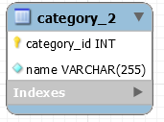
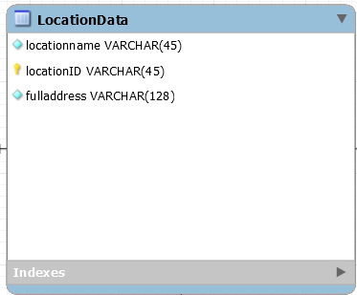
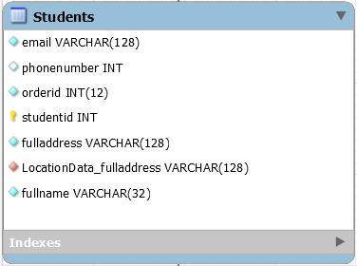
EER Diagram

Slide 10
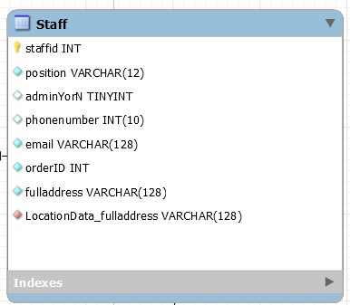
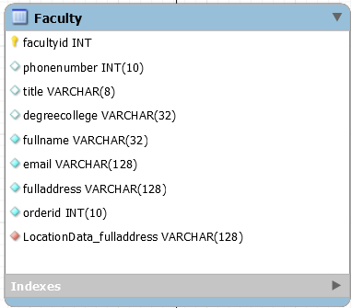
EER Diagram

Slide 11
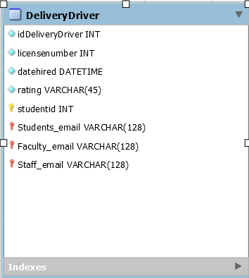
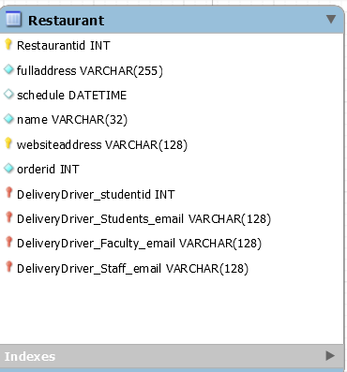
EER Diagram

Slide 12
Cardinality
Delivery Driver - Students driver - One to one
Students and location data -One to one
Faculty and location data- one-one
Location data and staff- One to one

Slide 13
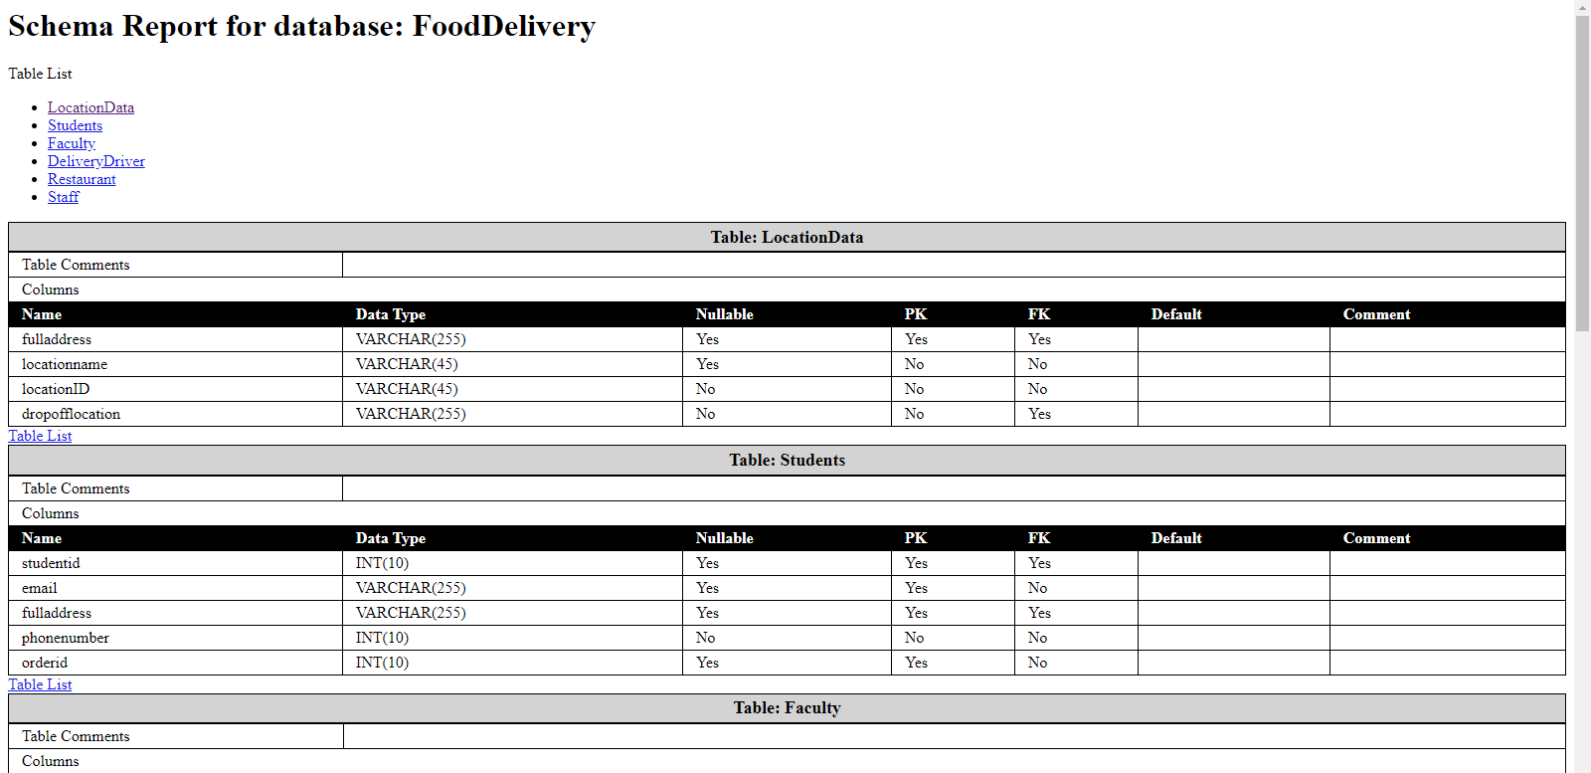
Schema
Food delivery My Sql schema

Slide 14
Thank you

